Slide 1
Inline System to Detect Hydrates, Wax and Sand Thomas M. Canty PE J.M. Canty Inc.

Slide 2
Introduction
Vision technology opens a wide range of application in the oil and gas industry. The visual component allows the operator, and software, to distinguish between oil/water, hydrates, wax and sand.
The visual component of the technology allows for classification by shape, color and transparency which is what is needed for classification of these constituents.
Fused Glass-to-Metal process lens enables, clear, clean and high pressure access to process.

Slide 3
Fundamentals of Vision
Illumination – bright, consistent
Camera/Lens – High resolution camera and optics for accurate measurement.
Rugged process lens which remains clean in the process flow, provides high pressure capabilities and can withstand extreme installation characteristics such as high and low temperature and vibration.

Slide 4
Illumination

Slide 5
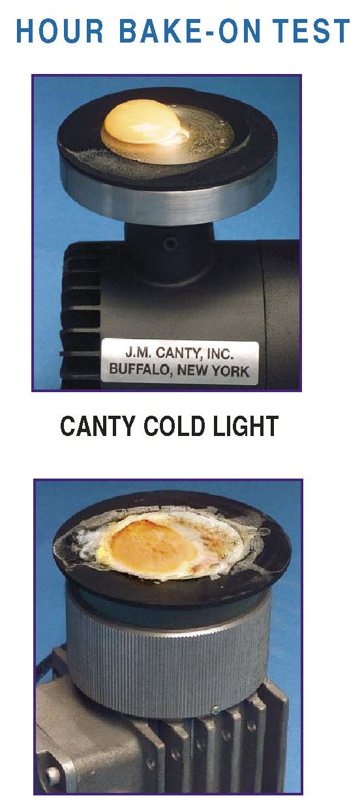
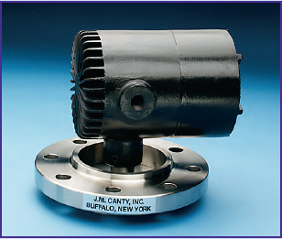
Lighting is critical for any vision based system
Canty have being doing process lighting for well over 30 years – part of our core business
Would not be so confident in our vision based technique without our lighting expertise
JM Canty, Inc. · Buffalo, New York · Phone: (716) 625-4227 | JM Canty, Ltd. · Dublin, Ireland · Phone: +353 (1) 882-9621

Slide 6
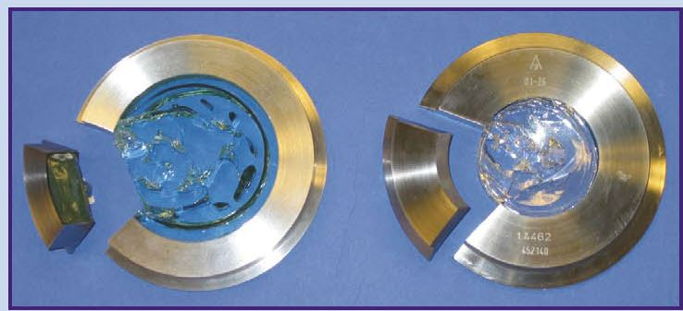
Canty’s Fused Glass Technology
Fusion of glass to metal – one piece construction
Critical to our vision based technique
Pressures to 10,000 PSI, Temp -450 to 800ºF
JM Canty, Inc. · Buffalo, New York · Phone: (716) 625-4227 | JM Canty, Ltd. · Dublin, Ireland · Phone: +353 (1) 882-9621

Slide 7
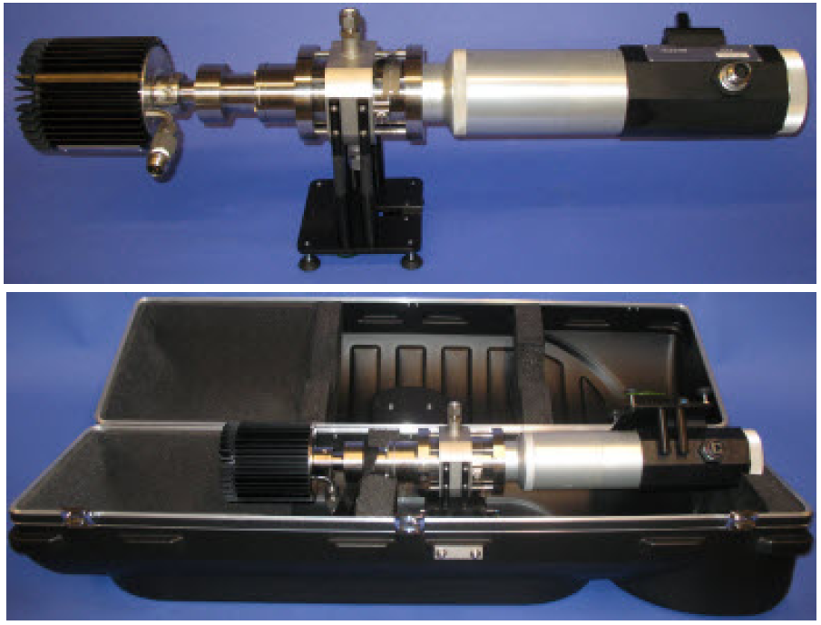
Lab and Portable imaging analyzer
JM Canty, Inc. · Buffalo, New York · Phone: (716) 625-4227 | JM Canty, Ltd. · Dublin, Ireland · Phone: +353 (1) 882-9621

Slide 8
Canty MicroFlow Cell

Slide 9
Typical In-Line System

Slide 10
Typical In-Line System

Slide 11
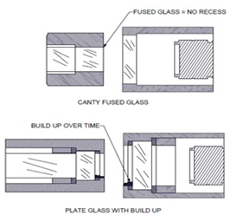
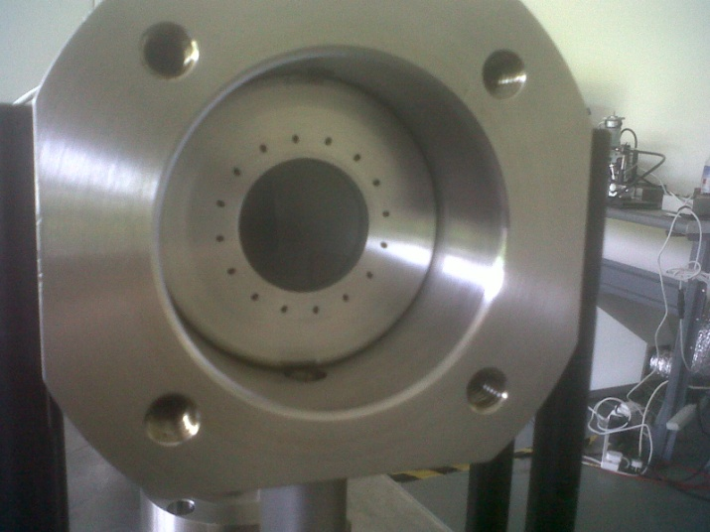
Measurement – Challenges
Fouling of Process Barrier
In order to provide consistent measurements, the barrier between the process and the sensor must remain clean
Solution:
Fusion of glass to metal Jet Spray Ring
JM Canty, Inc. · Buffalo, New York · Phone: (716) 625-4227 | JM Canty, Ltd. · Dublin, Ireland · Phone: +353 (1) 882-9621

Slide 12
Imaging / Software
High resolution CCD 1600 x 1200 Pixel
GigE transmission-Ethernet
High resolution lens to.7 micron
Shutter speed to 1/100,000 sec
Software capability to do size, shape and color analysis.
Operator adjustable based on view.

Slide 13
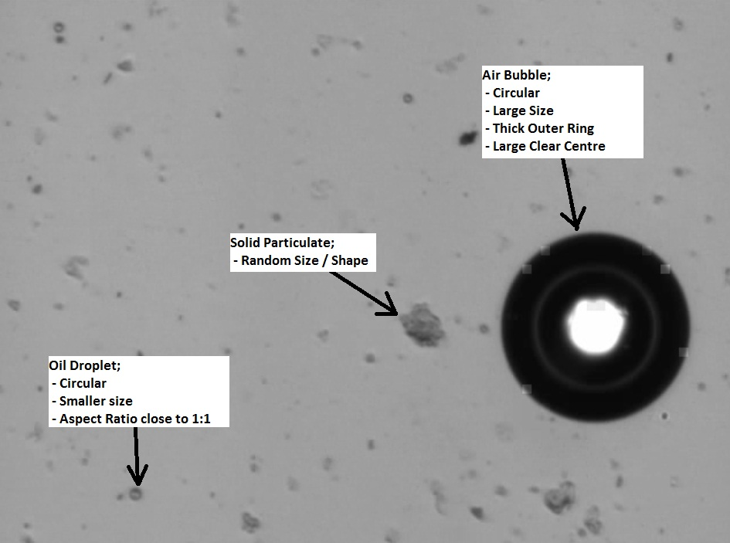
Measurement – Challenges
Reliability of Measurement
As there is various particulate suspended within the fluid, there needs to be some certainty that what the system is measuring is correct
Solution:
Software algorithms to identify and distinguish between different particulate types to provide size and concentration data for both hydrocarbons and solids
Visual Verification
JM Canty, Inc. · Buffalo, New York · Phone: (716) 625-4227 | JM Canty, Ltd. · Dublin, Ireland · Phone: +353 (1) 882-9621

Slide 14
Software Analysis Tools
Basic Particle Size:
Major / Minor Diameters
Shape Qualifiers:
Aspect Ratio
Circularity (Perimeter / Area)
Type Qualifiers:
Color
Transparency

Slide 15
Shape
Aspect Ratio – Sphere = 1, Needle = 5
Circularity – Sphere = 1/d, Square = 4/d
Hydrates in Oil ~ 2/d (large perimeter due to transparent center)
This filter can be used to detect particle agglomerations as well.

Slide 16
Presence of Hydrates and Wax

Slide 17
Image Discussion
Hydrates, circular heavy walled rings, are easily distinguished from oil due to their hollow centers. This yields a circularity value that is easily distinguishable from other type particles.
The wax formations are also distinguishable by size, circularity and transparency.

Slide 18
Sand

Slide 19
Sand Image
The previous image is highly magnified. Sand appears as generally crystalline shapes.
Through filter application it is distinguishable from wax, oil and hydrates

Slide 20
Conclusion
Visual technology provides the means to identify and classify process flow components.
Particle size and concentration can be determined in an accurate way. Size is determined generally by minor diameter which has the highest correlation to sieves.
Other technologies compute curve shapes based on statistical norms. Vision gives the actual data.

Slide 21
This concludes the Presentation!
Thanks for choosing CANTY!
See us in the Exhibitor Hall
For Further Information on this product please visit www.jmcanty.com.
JM Canty, Inc. · Buffalo, New York · Phone: (716) 625-4227 | JM Canty, Ltd. · Dublin, Ireland · Phone: +353 (1) 882-9621

